Slide 1
Integration of clinical criteria into the training of deep models: Application to glucose prediction for diabetic people
Smart Health, 2021
Citation: 5

Slide 2
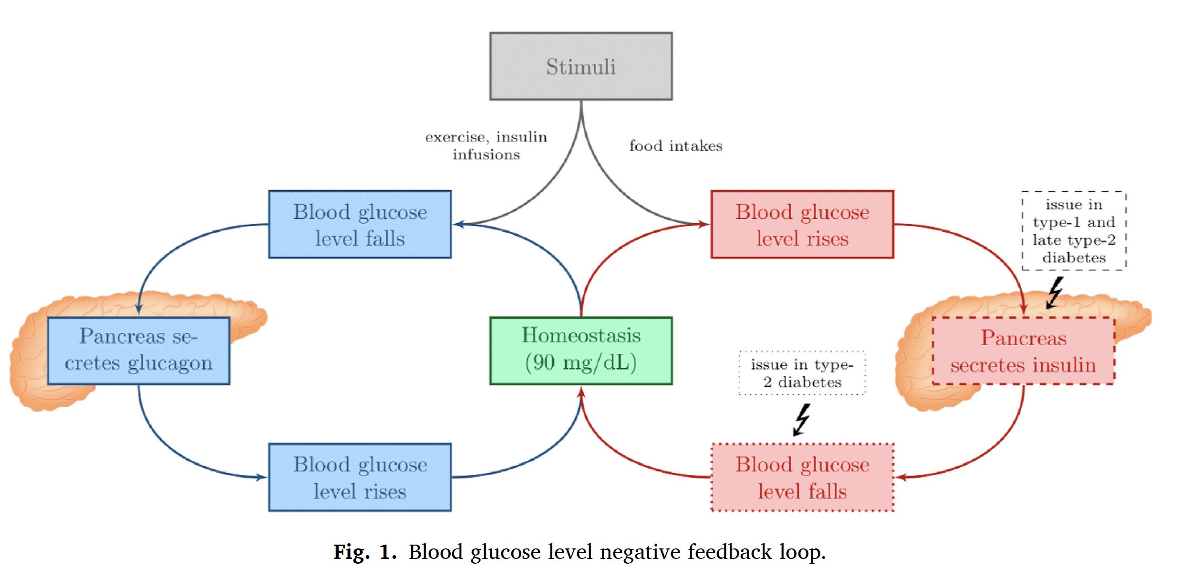
blood glucose level negative feedback loop
Notes:
The pancreas is responsible for most of the regulation in healthy individuals, releasing two different hormones: the insulin and the glucagon (see Fig. 1). However, for people with diabetes, this negative feedback loop is damaged.
stimuli = anything that disturbs the normal glucose level

Slide 3
Problem & Motivation
Traditional deep learning models for glucose prediction focus on statistical accuracy (e.g., MSE) but ignore clinical relevance.
This can lead to dangerous predictions, especially in hypo- and hyperglycemic regions.
Goal: Integrate clinical acceptability into training for safer, more meaningful predictions.

Slide 4
gcMSE loss function
gcMSE = coherent mean squared glycemic error — a new loss function designed specifically for glucose prediction that goes beyond the standard MSE.
Penalty for prediction errors → how far off is the predicted glucose value from the actual value (like MSE).
Penalty for predicted variation errors → does the model correctly predict whether glucose is rising, falling, or staying flat?
Extra penalty in dangerous regions (hypoglycemia) → these zones are more critical, so the model is trained to be more careful there.

Slide 5
PICA algorithm
PICA = Progressive Improvement of Clinical Acceptability
Starts by training a model for pure accuracy.
Then slowly reduces the importance of accuracy in the loss function.
Gradually increases the focus on clinical constraints (safety).
Stops when an optimal trade-off is found — the model is accurate enough and clinically safe
Notes:
It uses the gcMSE loss function, but it adjusts its weights over time.

Slide 6
CG-EGA metric
metric to assess the clinical acceptability of glucose predictive models
It's made of two parts:
CG-EGA = P-EGA + R-EGA

Slide 7
Point Error (P-EGA)
P-EGA measures the clinical accuracy of the predictions
This checks if the predicted glucose number is close to the real one.
Example:
Real glucose = 100
Predicted = 95 → ✅ Good (safe)
Predicted = 300 → ❌ Bad (very unsafe)
It compares number to number.

Slide 8
Rate Error (R-EGA)
measures the clinical accuracy of the predicted variations.
This checks if the direction is correct — is glucose going up, down, or staying flat?
Example:
Real glucose is going down fast
Predicted says it's going up → ❌ Very dangerous
Predicted says it's going down slowly → ⚠️ Less dangerous
Predicted also says it’s going down fast → ✅ Good
It compares change to change.
The predicted variations are computed as the rate of change between two consecutive predictions

Slide 9
The Final Score
clinical judgment
Based on both checks:
✅ AP = Accurate Prediction → Value and trend are both okay
⚠️ BE = Benign Error → A little off, but not dangerous
❌ EP = Erroneous Prediction → Could lead to danger

Slide 10
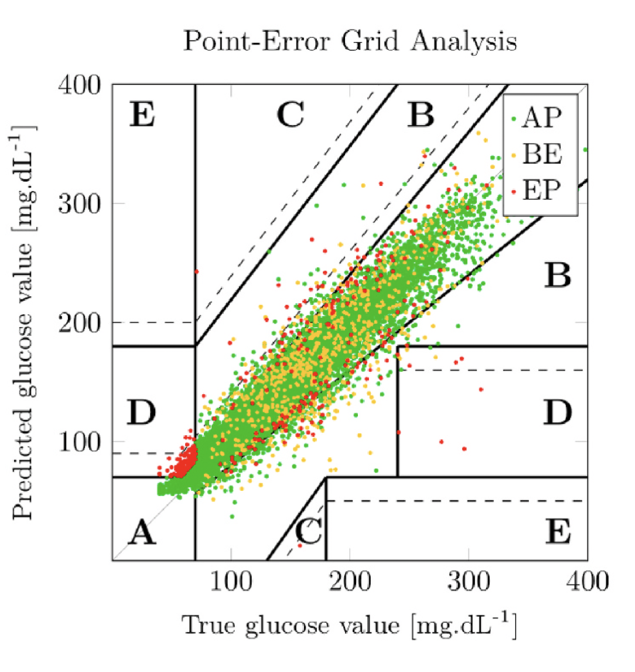
These zones label how clinically risky a prediction is, depending on how far it is from the real value.
✅ Zone A:
Very close to the correct value.
Clinically accurate.
Even if slightly off, the recommended action would still be safe.
⚠️ Zone B:
Slightly off, but still not dangerous.
Treatment decisions based on this would likely be acceptable.
⚠️ Zone C:
Predictions are noticeably wrong.
Might lead to overcorrection (e.g., take insulin when not needed).
❌ Zone D:
Seriously wrong predictions.
Could lead to missing hypo/hyperglycemia, or wrong treatment.
❌ Zone E:
Completely wrong.
Dangerous — likely to cause harm if acted on.

Slide 11
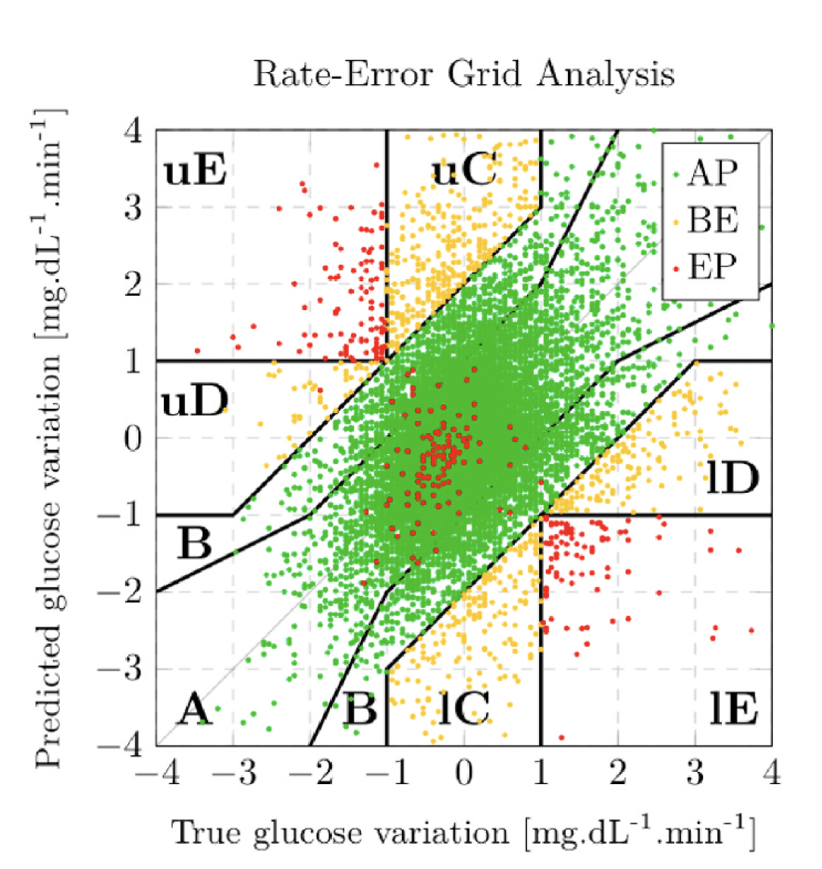
Zone | Meaning
A, B | Safe trend prediction
C | Slightly off, may cause confusion
D, E | Dangerous trend prediction — could cause wrong actions
u/l | "Upper/lower" = direction of error (too high or too low prediction)
Notes:
✅ Safe zones (mostly green dots):
Zone A: Predicted "big drop", and it actually dropped a lot — ✅ Good
Zone B: Small errors in trend — still safe
Zone C: Slight over/underestimation — borderline safe (orange)
⚠️ Middle zones (some orange/red):
uC (upper C) and lC (lower C):
You predicted the trend going up/down more than it really was
This could confuse the patient — e.g., looks like danger but isn’t
❌ Danger zones:
uD / uE and lD / lE (upper/lower D or E zones):
These are the worst zones
You predicted a completely wrong trend
Example:
Patient’s glucose is going down fast (real), but your model says it’s going up → ❌ This is lE zone
Patient’s glucose is rising fast, but your model says it’s dropping → ❌ uE zone
These are very risky because the patient might take the wrong action.

Slide 12
Label | Meaning | "u" or "l"? | Risk Level
uC | Upper C zone | "u" = over-predicting the rise | ⚠️ Medium risk
lC | Lower C zone | "l" = over-predicting the fall | ⚠️ Medium risk
iC | Inner C zone (center area) | No "u" or "l" – just slightly off near 0 change

Slide 13
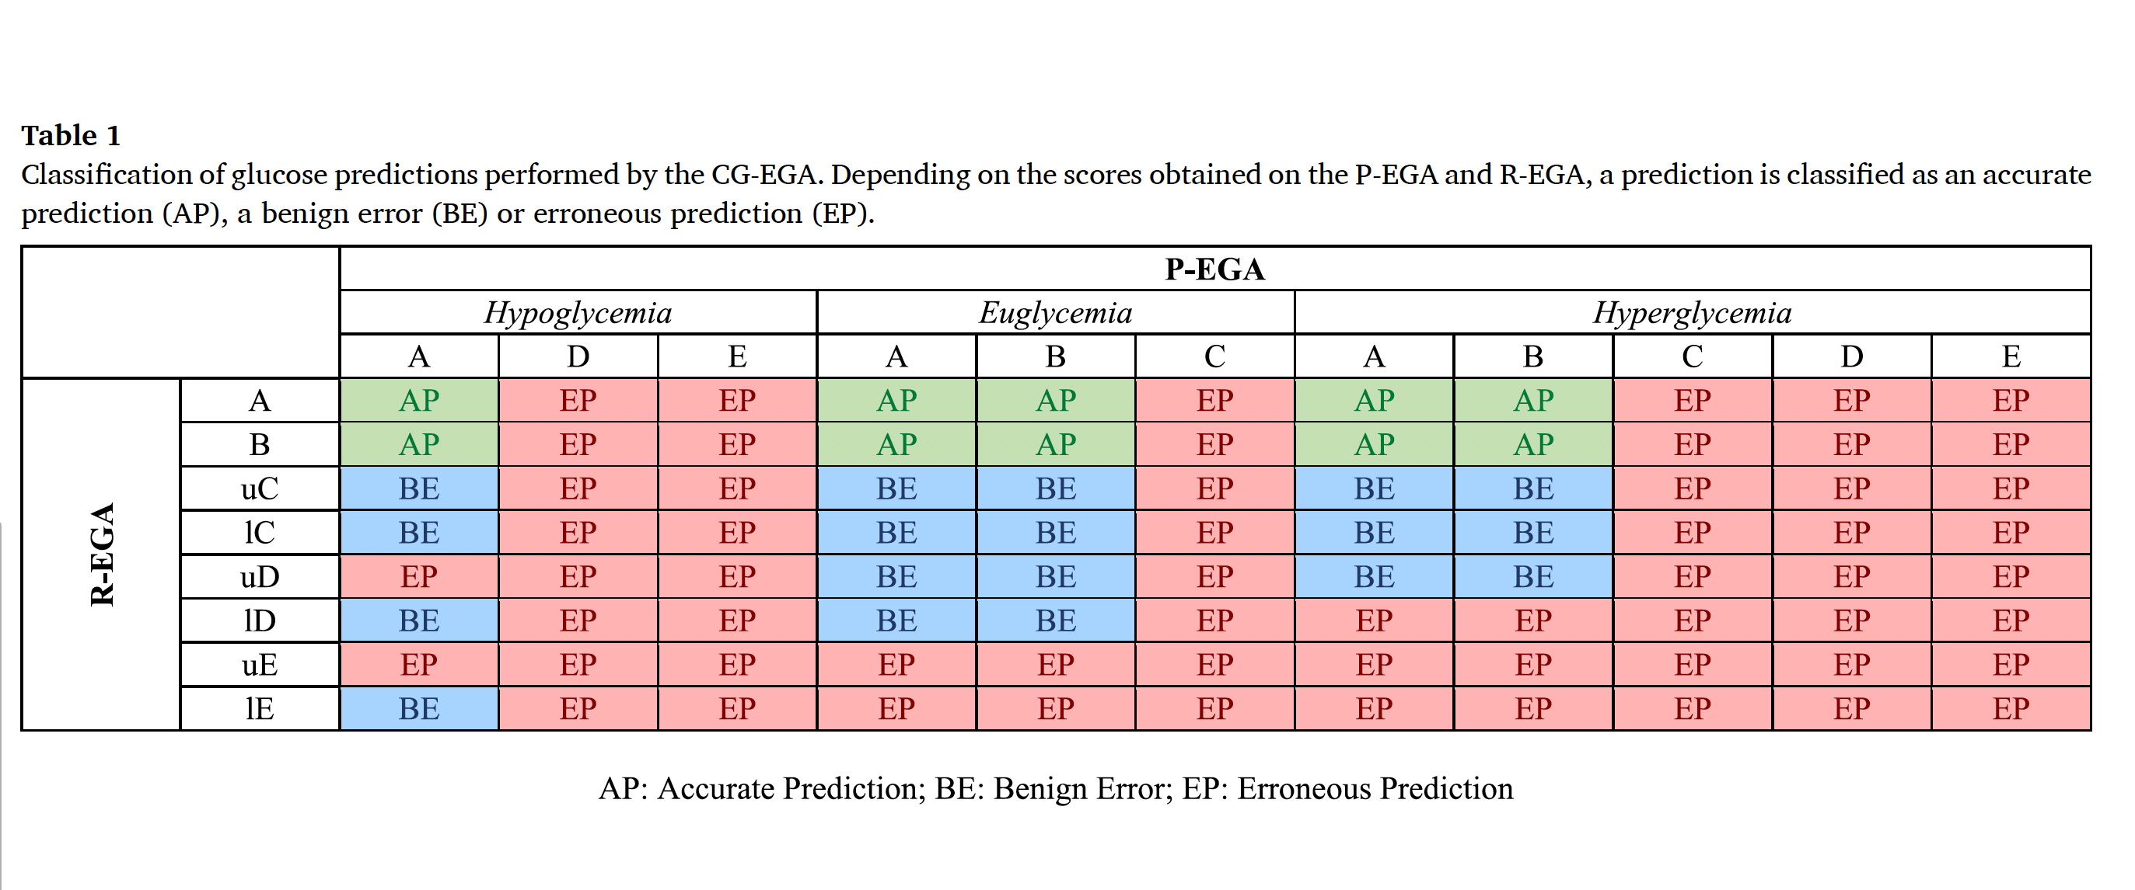
Notes:
In the hypoglycemia region, a lE score in R-EGA (predicting a drop when it’s actually rising) is treated as a benign error if the value prediction (P-EGA) was accurate (zone A).
Why?
Because if the model over-warns about low sugar, the patient might eat something — not ideal, but not deadly.
But:
uE or uD errors in hypoglycemia are dangerous, because they miss the fact that glucose is crashing — and that could lead to coma or death.
In the hypoglycemia region, even C-level mistakes are treated just as seriously as D or E
The table treats hypoglycemia, euglycemia, and hyperglycemia differently

Slide 14
Coherent mean squared error
Variation means:
How much glucose changes over time
It’s calculated like this:
Δg = gₜ - gₜ₋₁ (true variation)
Δĝ = ĝₜ - ĝₜ₋₁ (predicted variation)

Slide 15
The coherent mean squared error (cMSE) is a new loss function that combines two things:
1. Normal prediction error (MSE):
(gₙ - ĝₙ)² → Difference between predicted and true glucose values
2. Variation error (new):
(Δgₙ - Δĝₙ)² → Difference between real and predicted glucose change

Slide 16
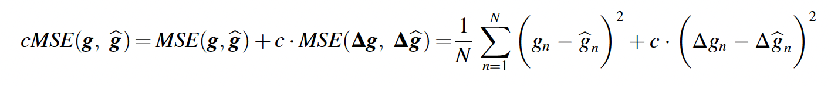
Combine both errors with a weight:
cMSE = MSE of glucose values + c ⋅ MSE of variations
The c is called the coherence factor:
• c = 0 → model only cares about values (regular MSE)
• c = 1 → equal focus on values and variations
• c = 10 → strong focus on variation accuracy

Slide 17
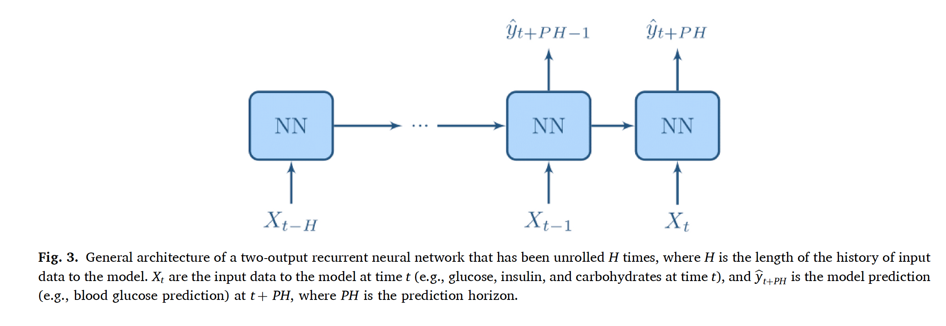
Notes:
This architecture is a sequence-to-two-point predictor: it looks at a past window of data and predicts glucose at two future time points. This allows training with the cMSE loss, which improves both accuracy and trend prediction.

Slide 18
Xₜ₋H : Input at time t minus H (e.g., 3 hours ago)
Xₜ₋₁ : Input at time just before now
Xₜ : Input right now
ŷₜ₊ₚₕ₋₁ : Prediction for glucose value 25 minutes in the future
ŷₜ₊ₚₕ : Prediction for glucose value 30 minutes in the future
To use the cMSE loss, we need to know how glucose is changing (variation).
So we calculate:
Δĝ = (ĝₜ₊ₚₕ - ĝₜ₊ₚₕ₋₁) / ΔT
This gives the predicted rate of glucose change over time.

Slide 19
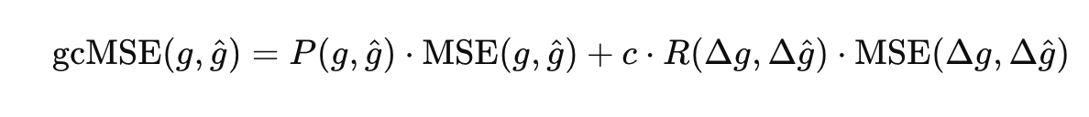
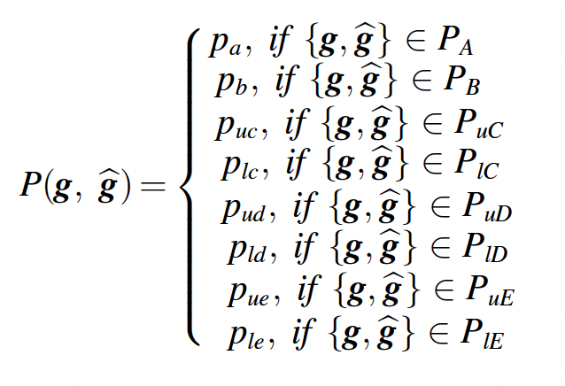
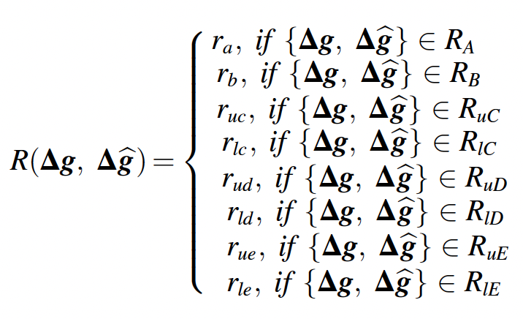
Coherent mean squared glycemic error
P-EGA-based weight
R-EGA-based weight
Notes:
c is a constant called the coherence factor. It controls how much the model should care about predicting the trend

Slide 20
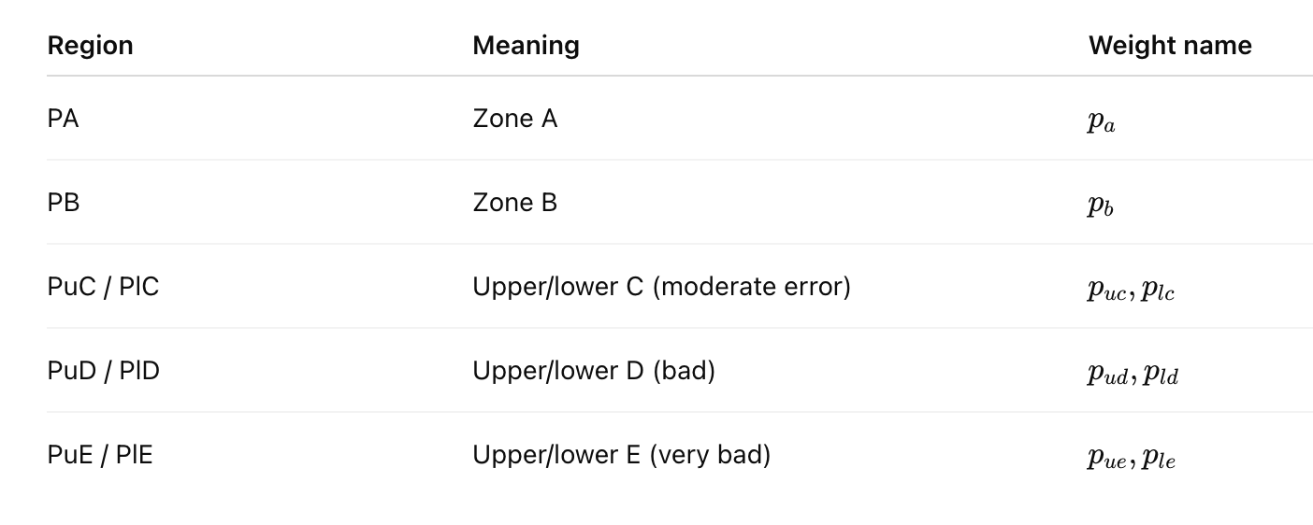
P(g, ĝ): P-EGA region-based weight

Slide 21
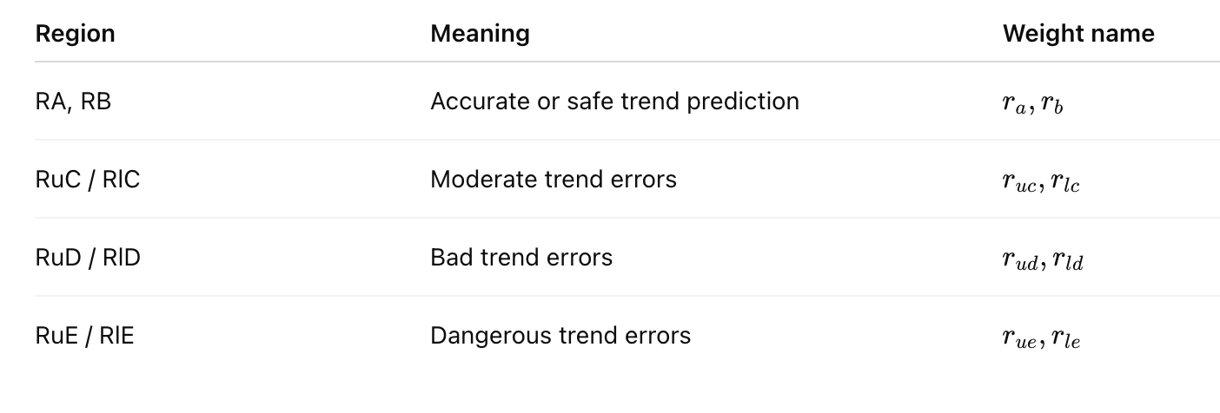
R(Δg, Δĝ): R-EGA region-based weight

Slide 22
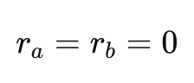
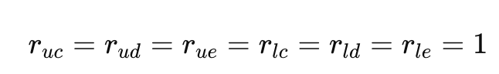
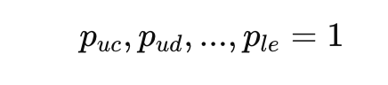
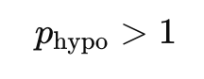
The full gcMSE loss function has 14 weights ->
Tuning all of these is too complex and time-consuming.
Simplify it to just 3 hyperparameters
predictions in R-EGA zones A and B already show a correct trend, they don’t need to be improved.
From a clinical point of view, once you're outside zone A/B, any error could be harmful. So, no need to tune each zone separately.
Make hypoglycemia especially important
So give extra weight to errors in the PuD and PuE zones

Slide 23
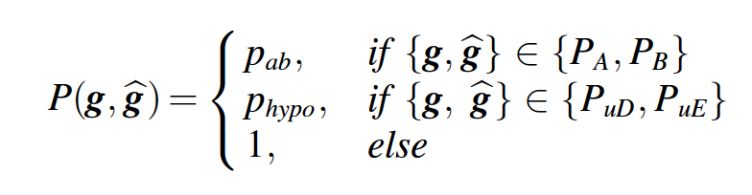
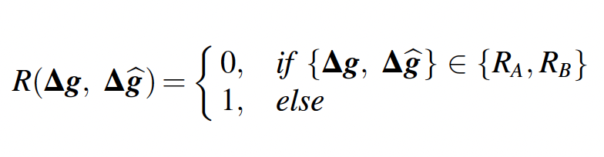
Simplified gcMSE equations:
the gcMSE cost function to have only 3 hyperparameters: pab, phypo, and c.
Notes:
if in zone A or B
if in PuD or PuE
otherwise​
pabp_{ab}pab​ — weight for predictions in P-EGA zones A and B (safe zones) ✅ This is the one PICA adjusts over time to reduce focus on easy/safe predictions.
phypop_{hypo}phypo​ — extra weight for hypoglycemia regions (PuD, PuE) 🔒 This stays fixed in PICA (set manually, e.g., 10) to emphasize hypoglycemia throughout training.
ccc — coherence factor: controls the balance between value error and trend error 🔒 Also stays fixed in PICA (e.g., c = 2 or 8 depending on the dataset)

Slide 24
Balancing Accuracy and Clinical Safety
📈 Statistical Accuracy vs. 🩺 Clinical Acceptability (CG-EGA) → Can't fully optimize both at the same time → MOO Problem
⚠️ Challenges
❌ No official CG-EGA standards
❌ Full model search is too slow (Grid Search, NSGA-II)
To train a model that:
✅ Is as accurate as possible
✅ And also meets a clinical safety rule (e.g., 95% AP or less than 1% EP in CG-EGA)
Solution: PICA Algorithm
Notes:
Using the gcMSE loss introduces two competing goals: accuracy and clinical safety. This makes the training process a multi-objective optimization problem.
In such problems, you don’t find a single perfect solution — instead, you get a set of Pareto-optimal solutions, where improving one goal would hurt the other. The final model is selected by choosing the right balance based on medical priorities.
Clinical thresholds (like 95% AP, <1% EP):
These thresholds are not zones, but rules you create based on CG-EGA output labels:
“At least 95% of predictions should be AP” = 95% of your predictions must be clinically safe
“Less than 1% should be EP” = model must avoid dangerous errors
This is how PICA knows whether your model is clinically acceptable
PICA gradually shifts a model from high accuracy to higher clinical safety, and stops as soon as it finds a model that is both good enough clinically and better than a naive guess.

Slide 25
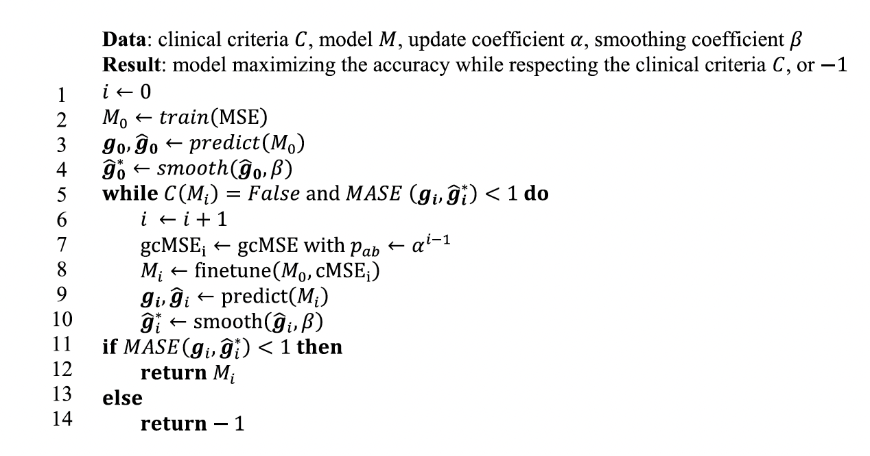
PICA
Goal of the Algorithm:
Find the most accurate model that also satisfies clinical safety rules.
Notes:
2-Train the initial model M₀ using MSE loss (pure accuracy — no clinical focus).
3-Use model M₀ to make predictions
4-Apply exponential smoothing to reduce sharp noise in predictions
5-Only keep training if:
The model doesn’t meet the clinical rule yet
And it is still better than a naive model (MASE < 1)
7-Create a new loss function:
Use gcMSE (which includes clinical focus)
Set Pab=α^i−1→ this makes the model care less about accuracy and more about clinical safety with each step (α is a number between 0 and 1 )
8-Fine-tune the original model M₀using the new gcMSE loss
12-If model now meets the clinical rule and still has decent accuracy → ✅ Return this model
13-If model gets too bad (MASE ≥ 1), stop and return −1, meaning no acceptable model found.

Slide 26
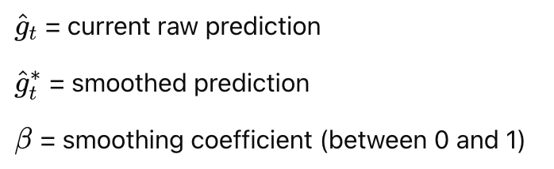
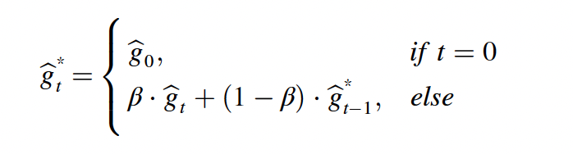
exponential smoothing
model predictions can be jumpy or noisy, and those fluctuations are not real
Notes:
Line 4 smooths the predicted glucose values to reduce fake spikes and make the signal more realistic before checking if the model meets clinical safety criteria. This helps avoid penalizing the model for noisy behavior that doesn’t reflect real glucose patterns.
The new smoothed value is a mix of the current prediction and the previous smoothed value
β close to 1 = keep the prediction mostly as it is (less smoothing)
β small (e.g., 0.2) = smooth it a lot more

Slide 27
Experimental Methodology
Datasets
IDIAB: 6 patients with type 2 diabetes
31 days of real-world data (FreeStyle Libre, mySugr app)
OhioT1DM: 6 patients with type 1 diabetes
8 weeks of public data
Preprocessing Steps
Cleaning: remove noisy glucose spikes (e.g., sensor glitches)
Resampling: align signals to 5-minute intervals
Windowing: 3-hour history to predict glucose 30 min ahead
Handling missing data: linear interpolation and filtering
Feature scaling: normalize inputs
Post-Processing
Exponential smoothing of predictions (β) → reduces noise, improves stability
Evaluation Metrics
MSE, MAPE, MASE: numerical accuracy
CG-EGA (AP, BE, EP): clinical safety

Slide 28
Models
SVR / SVR*: Traditional regression model (baseline, with/without smoothing)
LSTM / LSTM*: Deep learning model trained with standard MSE (with/without smoothing)
pcLSTM / pcLSTM*: LSTM trained with cMSE (penalizes trend errors)
gpcLSTM / gpcLSTM*: LSTM trained with gcMSE (adds clinical zone weights)
gpcLSTM_CA: Trained with gcMSE but ignores accuracy — maximizes clinical safety
gpcLSTM*_PICA: Trained with PICA algorithm — balances accuracy and safety

Slide 29
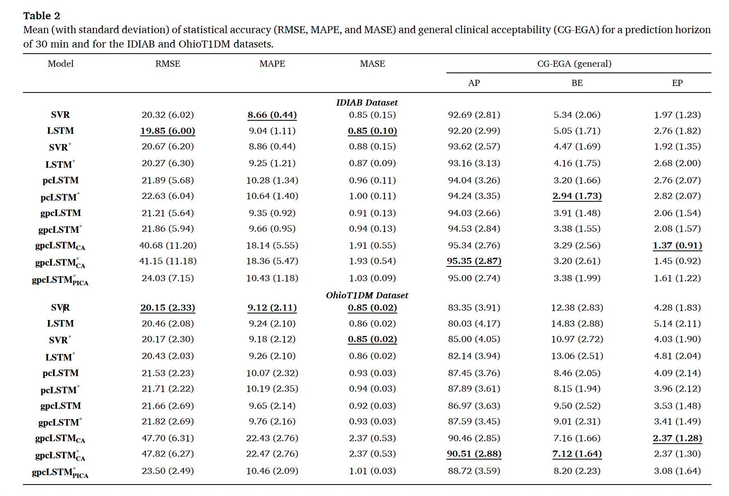

Slide 30
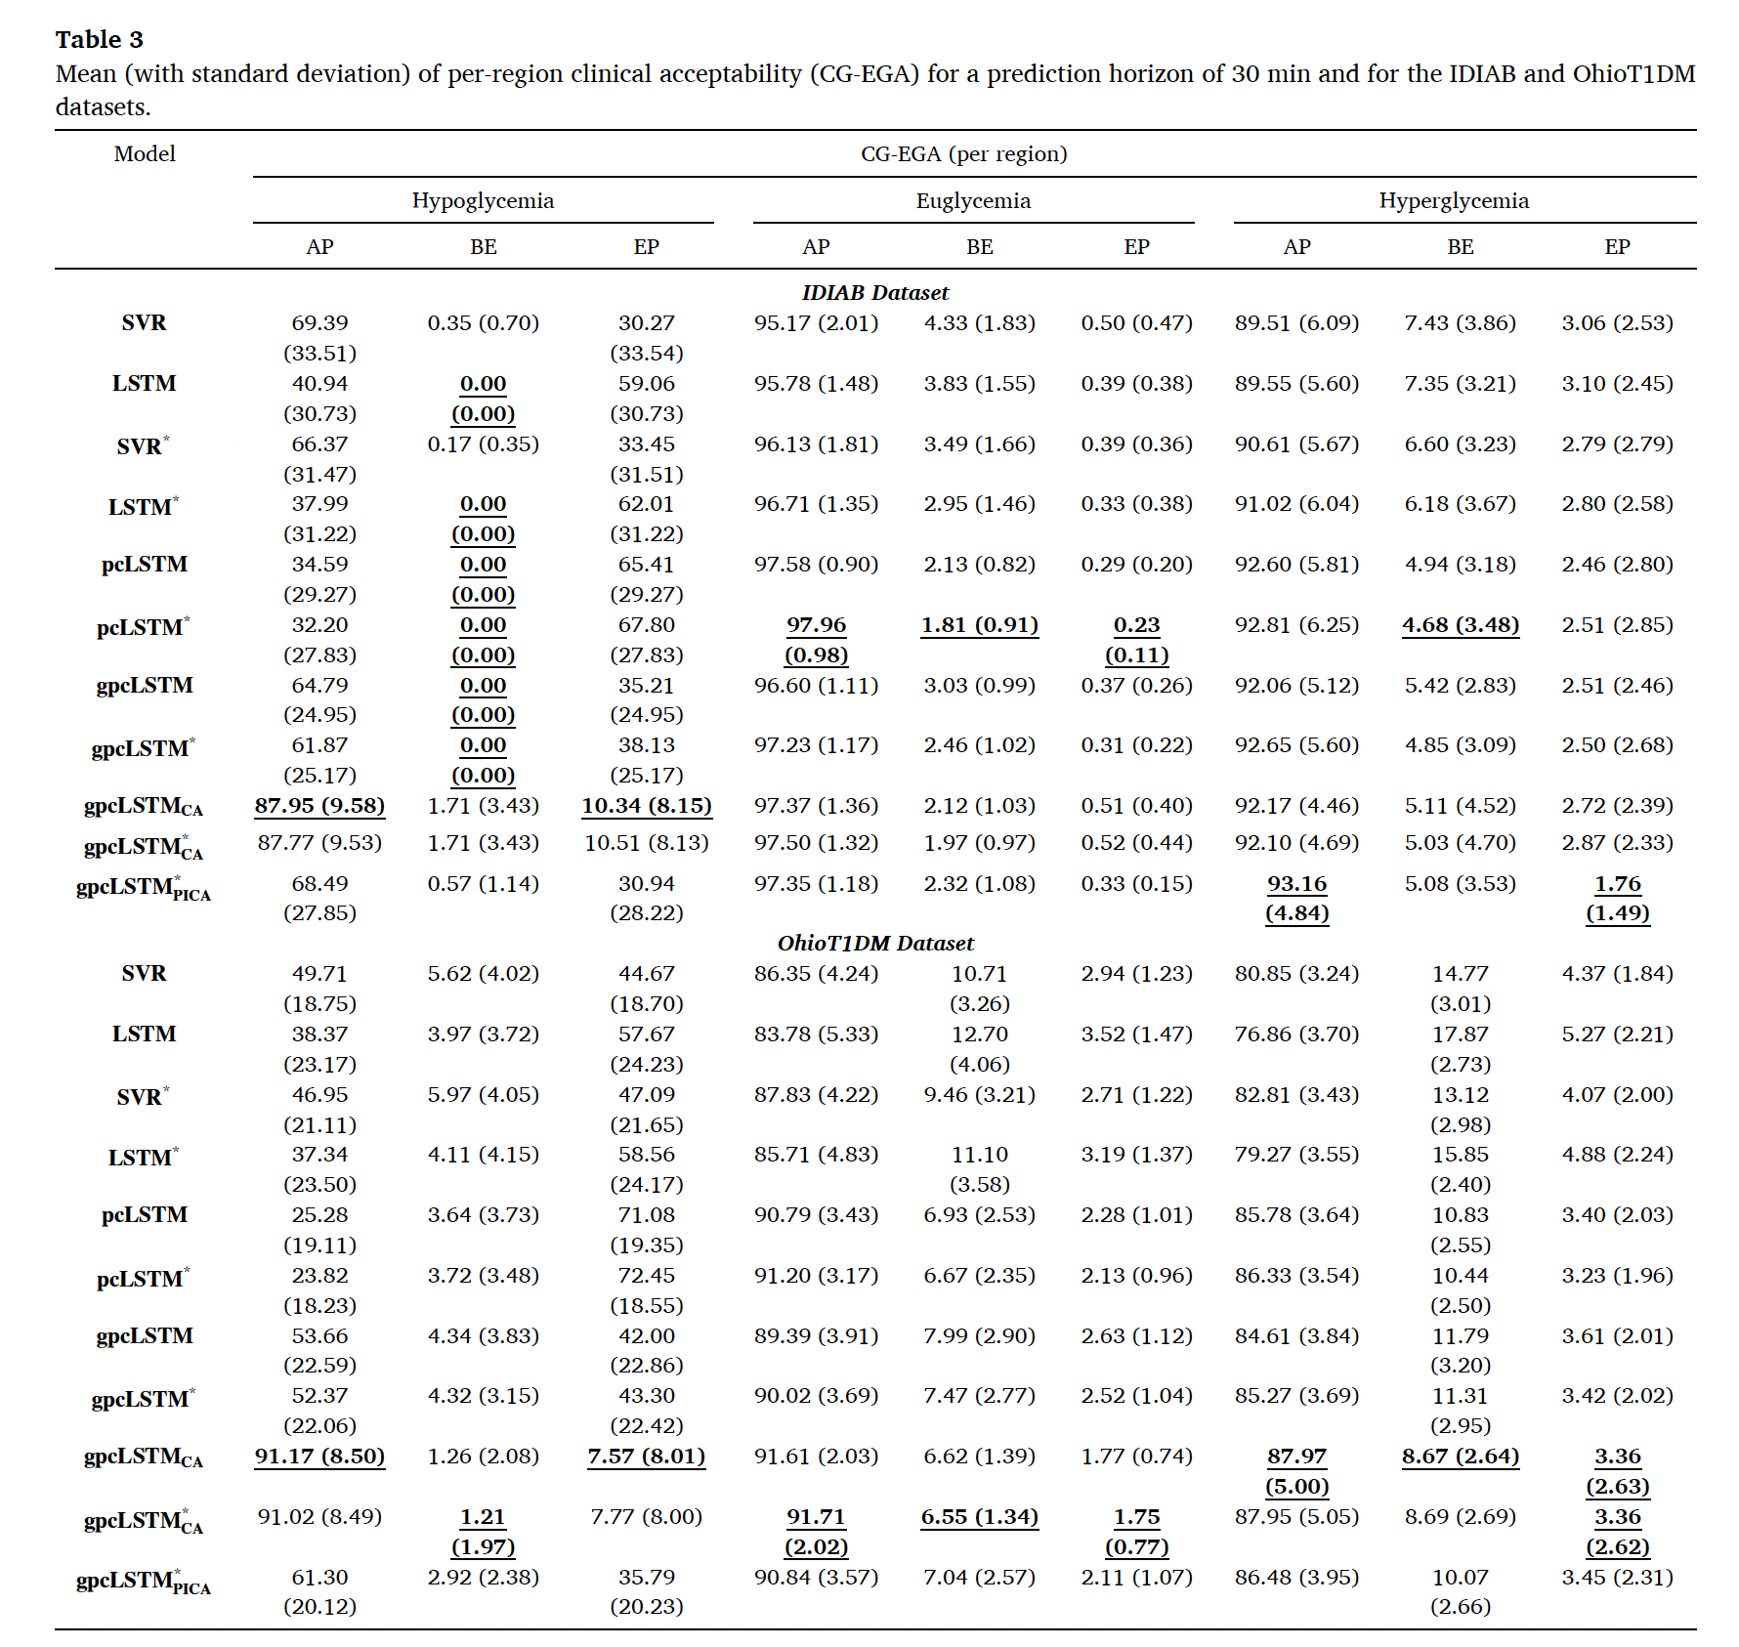

Slide 31
Goal | Best Model
Maximum clinical safety | gpcLSTM_CA
Balanced model | gpcLSTM*_PICA
Best raw accuracy | LSTM or SVR
Avoid at all costs if safety matters | LSTM / SVR (unsmoothed)

Slide 32
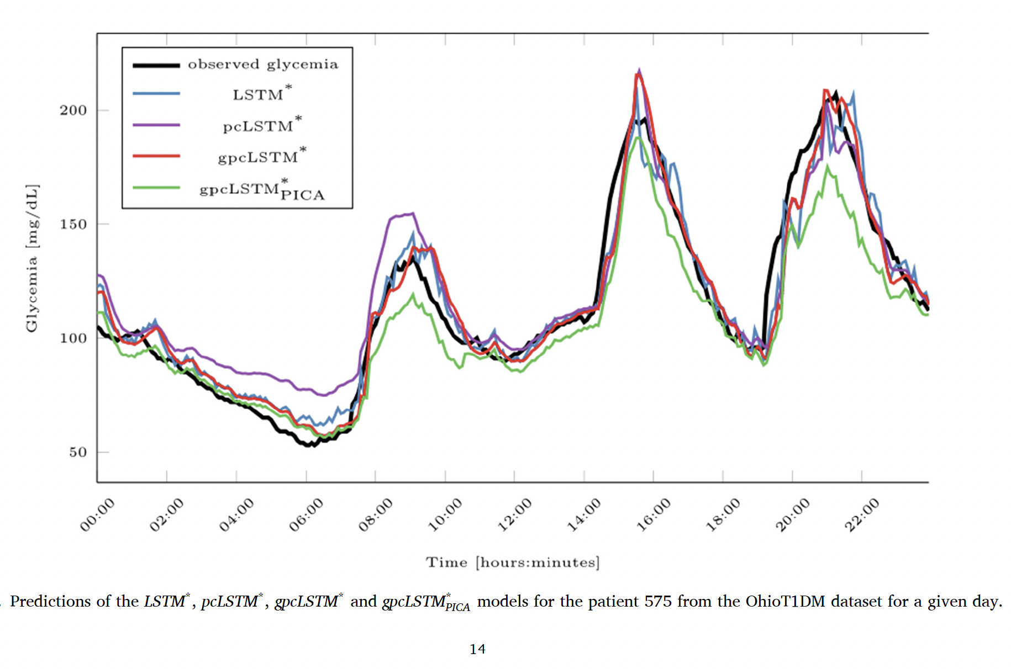

Slide 33
Thank you
Questions ?

